Slide 1
Agile Software Development
CSE 470 : Software Engineering

Slide 2
Topics
Agile Software Development
Agile manifesto
Agile Characteristics
Existing Agile Methods
Extreme Programming
Agile Unified Process
Scrum

Slide 3
Agile Software Development (cont.)
Dissatisfaction with the overheads involved in software design methods of the 1980s and 1990s led to the creation of agile methods. These methods:
Focus on the code rather than the design
Are based on an iterative approach to software development
Are intended to deliver working software quickly and evolve quickly to meet changing requirements.
The aim of agile methods is to reduce overheads in the software process (e.g. by limiting documentation) and to be able to respond quickly to changing requirements without excessive rework.

Slide 4
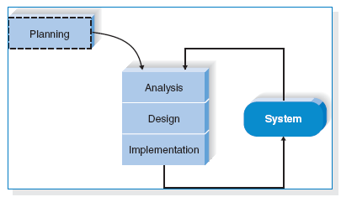
Agile Software Development (cont.)
Agile software development is a conceptual framework for software engineering that promotes development iterations throughout the life-cycle of the project.
Software developed during one unit of time is referred to as an iteration, which may last from one to four weeks.
Agile methods also emphasize working software as the primary measure of progress

Slide 5
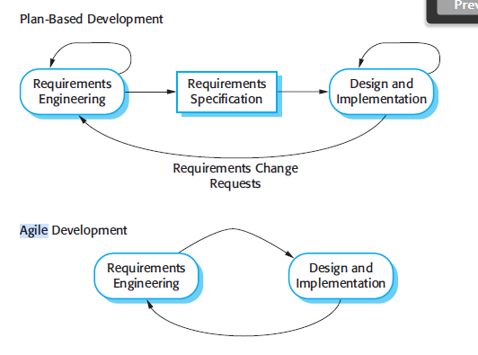
Plan-driven and agile specification

Slide 6
Agile Software Development (cont.)
Characteristics of Agile Software Development
-- Light Weighted methodology
-- Small to medium sized teams
-- vague and/or changing requirements
-- vague and/or changing techniques
-- Simple design
-- Minimal system into production

Slide 7
Agile manifesto
We are uncovering better ways of developing software by doing it and helping others do it. Through this work we have come to value:
Individuals and interactions over processes and tools Working software over comprehensive documentation Customer collaboration over contract negotiation Responding to change over following a plan
That is, while there is value in the items on the right, we value the items on the left more.

Slide 8
Agile Characteristics
Modularity
Iterative
Time-bound
Incremental
Convergent
People-oriented
Collaborative

Slide 9
Existing Agile Methods
Extreme Programming (“XP”)
Agile Unified Process
Scrum

Slide 10
Extreme Programming
Perhaps the best-known and most widely used agile method.
Extreme Programming (XP) takes an ‘extreme’ approach to iterative development.
New versions may be built several times per day;
Increments are delivered to customers every 2 weeks;
All tests must be run for every build and the build is only accepted if tests run successfully.

Slide 11
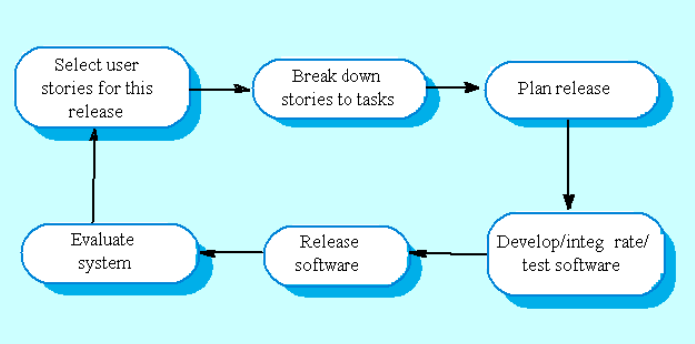
Extreme Programming

Slide 12
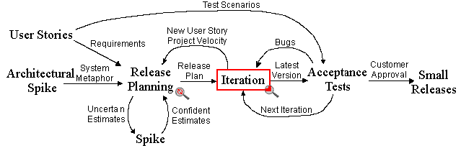
Extreme Programming Project

Slide 13
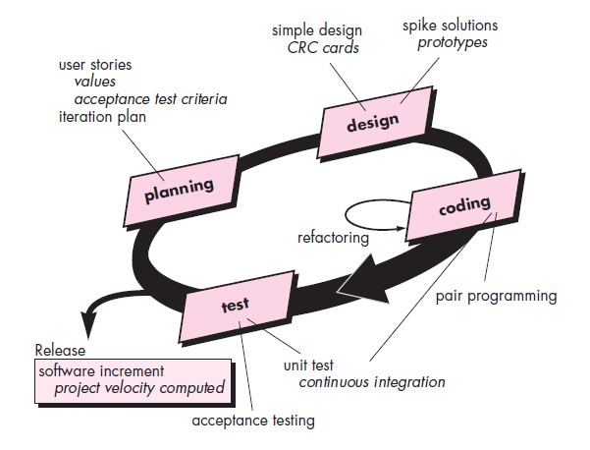
Extreme Programming Project
CRC - class-responsibility collaborator

Slide 14
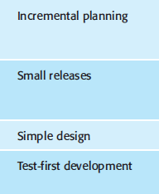
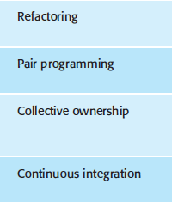
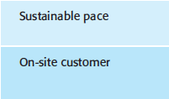
XP Principle or Practice

Slide 15
Agile Unified Process
Agile Unified Process (AUP) is a simplified version of the Rational Unified Process (RUP).
Phases of AUP
Inception (scope of the project)
Elaboration (basic architecture design)
Construction (implementation)
Transition (final product release)
Notes:
The initial step in the AUP is the model workflow which begins with the Inception phase. Here project scope, risks, costs and schedule, and project feasibility are defined, including the preparation for the project environment.
The requirement's phase includes identifying the stakeholders, understanding the user's problem, establishing a basis of estimation, and defining the user interface for the system. Although these activities occur during the Inception and Elaboration phases, they can continue through other phases to improve the unfolding design.
During the construction phase, user stories are implemented and iteratively reworked to reflect the expanding understanding of the problem domain as the project progresses

Slide 16
Disciplines of AUP
Business Modelling (requirements and design)
Implementation
Test
Deployment
Configuration and Change Management
Project Management
Environment

Slide 17
Scrum
It is an Agile S/W development method for project management
Characteristics:
Prioritized work is done
Completion of backlog items
Progress is explained
Agile Software Development

Slide 18

Scrum Framework
Roles
Product owner
Scrum Master
Team
Ceremonies
Sprint planning
Sprint review and Sprint retrospective
Daily scrum meeting
Artifacts
Product backlog
Sprint backlog
Burndown charts

Slide 19
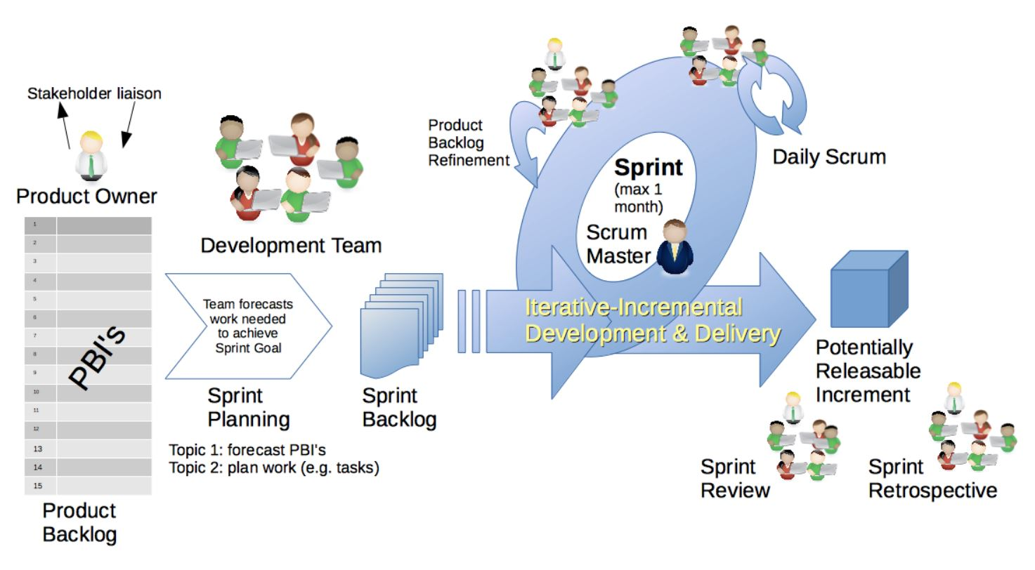
Scrum Framework (cont.)

Slide 20







Scrum Roles
Product Owner
Possibly a Product Manager or Project Sponsor
Decides features, release date, prioritization, $$$
Scrum Master
Typically a Project Manager or Team Leader
Responsible for enacting Scrum values and practices
Remove impediments / politics, keeps everyone productive
Project Team
5-10 members; Teams are self-organizing
Cross-functional: QA, Programmers, UI Designers, etc.
Membership should change only between sprints

Slide 21



Sprint Planning Mtg.
Team capacity
Sprint planning meeting
Sprint prioritization
Sprint
goal
Product backlog
Analyze/evaluate product backlog
Select sprint goal
Business conditions
Sprint planning
Decide how to achieve sprint goal (design)
Create sprint backlog (tasks) from product backlog items (user stories / features)
Estimate sprint backlog in hours
Current product
Sprint
backlog
Technology

Slide 22
Daily Scrum Meeting
Parameters
Daily, ~15 minutes, Stand-up
Anyone late pays a $1 fee
Not for problem solving
Whole world is invited
Only team members, Scrum Master, product owner, can talk
Helps avoid other unnecessary meetings
Three questions answered by each team member:
What did you do yesterday?
What will you do today?
What obstacles are in your way?
Notes:
22

Slide 23
Scrum's Artifacts
Scrum has remarkably few artifacts
Product Backlog
Sprint Backlog
Burndown Charts
Can be managed using just an Excel spreadsheet
More advanced / complicated tools exist:
Expensive
Web-based – no good for Scrum Master/project manager who travels
Still under development

Slide 24

Product Backlog
The requirements
A list of all desired work on project
Ideally expressed as a list of user stories along with "story points", such that each item has value to users or customers of the product
Prioritized by the product owner
Reprioritized at start of each sprint
This is the product backlog

Slide 25
User Stories
Instead of Use Cases, Agile project owners do "user stories"
Who (user role) – Is this a customer, employee, admin, etc.?
What (goal) – What functionality must be achieved/developed?
Why (reason) – Why does user want to accomplish this goal?
As a [user role], I want to [goal], so I can [reason].
Example:
"As a user, I want to log in, so I can access subscriber content."
story points: Rating of effort needed to implement this story
common scales: 1-10, shirt sizes (XS, S, M, L, XL), etc.

Slide 26
Sample Product Backlog
Backlog item | Estimate
Allow a guest to make a reservation | 3 (story points)
As a guest, I want to cancel a reservation. | 5
As a guest, I want to change the dates of a reservation. | 3
As a hotel employee, I can run RevPAR reports (revenue-per-available-room) | 8
Improve exception handling | 8
... | 30
... | 50
Notes:
26

Slide 27
Sprint Backlog
Individuals sign up for work of their own choosing
Work is never assigned
Estimated work remaining is updated daily
Any team member can add, delete change sprint backlog
Work for the sprint emerges
If work is unclear, define a sprint backlog item with a larger amount of time and break it down later
Update work remaining as more becomes known

Slide 28
Sample Sprint backlog
Tasks
Mon
Tue
Wed
Thu
Fri
Code the user interface
8
4
8
Code the middle tier
16
12
10
4
Test the middle tier
8
16
16
11
8
Write online help
12
Write the Foo class
8
8
8
8
8
Add error logging
8
4
Notes:
28

Slide 29
Sprint Burndown Chart
A display of what work has been completed and what is left to complete
one for each developer or work item
updated every day
(make best guess about hours/points completed each day)
variation: Release burndown chart
shows overall progress
updated at end of each sprint

Slide 30
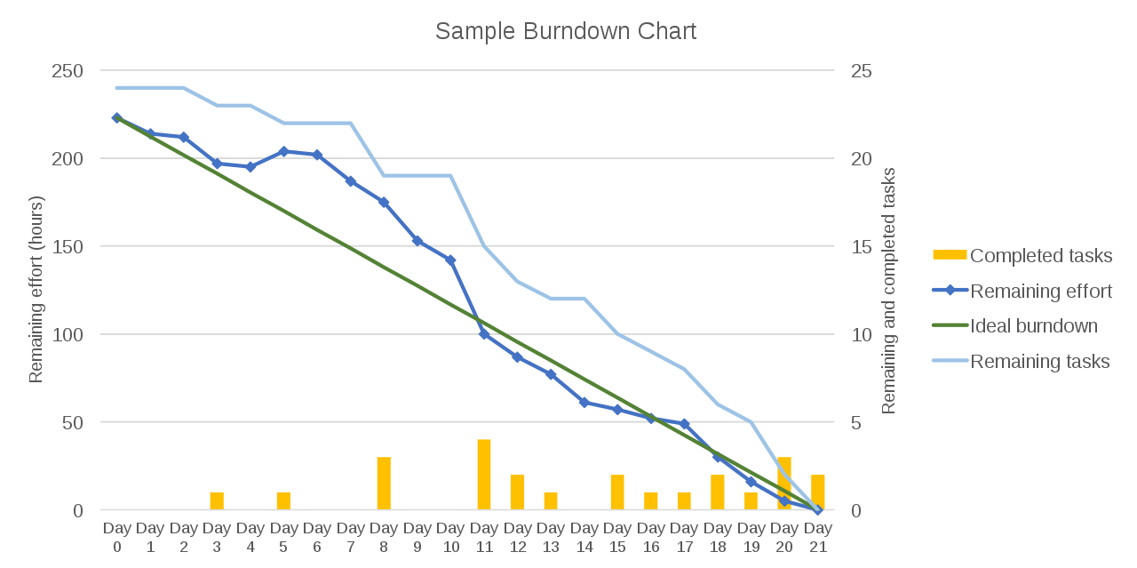
Sprint Burndown Chart

Slide 31
The Sprint Review
Team presents what it accomplished during the sprint
Typically takes the form of a demo of new features or underlying architecture
Informal
2-hour prep time rule
No slides
Whole team participates
Invite the world

Slide 32
Credits, References
Mike Cohn, Mountain Goat Software www.mountaingoatsoftware.com
Scrum and The Enterprise by Ken Schwaber
Succeeding with Agile by Mike Cohn
Agile Software Development Ecosystems by Jim Highsmith
Agile Software Development with Scrum by K. Schwaber and M. Beedle
User Stories Applied for Agile Software Development by Mike Cohn
www.agilescrum.com/
www.objectmentor.com
jeffsutherland.com/
www.controlchaos.com/scrumwp.htm
agilealliance.com/articles/articles/InventingScrum.pdf

